Slide 1
Course Logistics and Introduction
CS771: Introduction to Machine Learning
Piyush Rai

Slide 2
Course Logistics
Course name: Introduction to Machine Learning CS771A)
Timing and Venue: Mon/Thur 6:00-7:30pm, L-20
Course website: https://tinyurl.com/cs771-a23 (slides, readings, etc)
Online discussion/QA: Piazza (https://tinyurl.com/cs771-a23-piazzasignup)
Instructor’s contact email: piyush@cse.iitk.ac.in, office: RM-502 (CSE dept)
Prefix email subject with CS771, else might get ignored
Use of Piazza is encouraged for course-related matters (also has private messaging)
Office hours: Wed 6pm-7pm (or by appointment)
Unofficial auditors are welcome. However, can’t participate in exams/quizzes
Can attempt homeworks, quizzes, exams on their own. Won’t be graded

Slide 3
Course Team (TAs)
TA office locations and office hours announced soon
Aditya Dhaulakhandi (adityad@cse)
Subhajit Panday (subhajitpanday@cse)
Malay Pandey (malay@cse)
Abhishek Jaiswal (abhijais@cse),
Putrevu Venkata Sai Charan (pvcharan@cse)
Pramit Bhattacharyya (pramitb@cse)
Gargi Sarkar (gsarkar@cse)
Virendra Nishad (viren@cse)
Priyanka Maity (priyankamaity@cse)
Ayush Pande (ayushp@cse)
Debkanta Chakraborty (debkanta@cse)
Saqib Sarwar (saqib@cse)

Slide 4

Workload and Grading Policy
Quizzes will be closed-book. For exams, one A4 size cheat-sheet will be allowed
4 quizzes: 30%
2 homeworks/mini-projects: 20%
Writeups must be prepared in PDF using the provided LaTeX template
Knowledge of Python programming is assumed (will have a tutorial this weekend)
Mid-sem exam: 20%
End-sem exam: 30%
Quiz dates (tentative): Aug 16, Sept 5, Oct 13, Nov 7
Quiz timing and venue: will be announced closed to the quiz date
HW/mini-project dates (tentative): Aug 17, Oct 2 (roughly 3 work-weeks given)
Mid-sem and end-sem exam dates: As per DOAA announcements

Slide 5
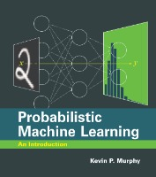
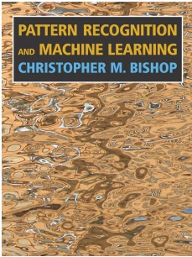
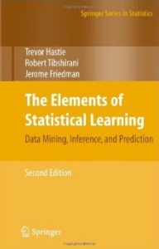
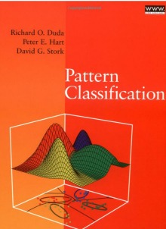

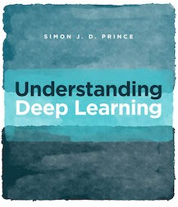
Textbook and References
Many excellent texts but none “required”. Some include:
See the course website for links and other relevant texts and references
Different books might vary in terms of
Set of topics covered
Flavor (e.g., classical statistics, deep learning, probabilistic/Bayesian, theory)
Terminology and notation (beware of this especially)
For each topic in the course, we will provide you recommended readings

Slide 6
Course Goals
Introduction to the foundations of machine learning (ML)
Focus on developing the ability to
Understand the underlying principles (and maths ☺) behind ML models and algos
Understand how to implement and evaluate them
Understand/develop intuition on choosing the right ML model/algo for your problem
(Hopefully) inspire you to work on and learn more about ML
Not an intro to popular software frameworks and libraries, such as scikit-learn, PyTorch, Tensorflow, etc
However, you are encouraged to explore these as the course progresses
See the course website for links and other relevant texts and references
Different books might vary in terms of
Set of topics covered
Flavor (e.g., classical statistics, deep learning, probabilistic/Bayesian, theory)
Terminology and notation (beware of this especially)
We will provide you the reading material from the relevant sources

Slide 7
What Is Machine Learning?

Slide 8
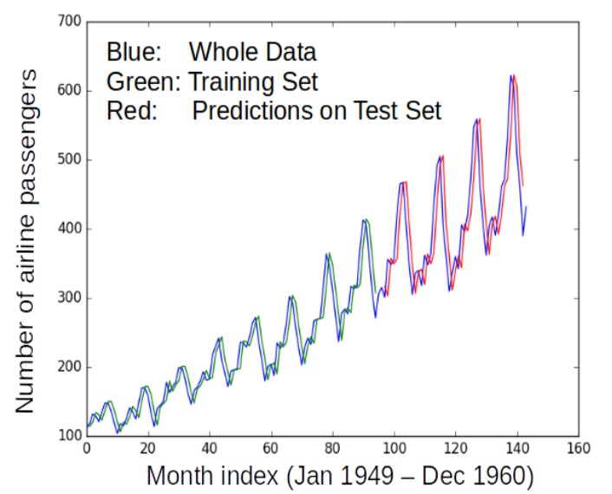
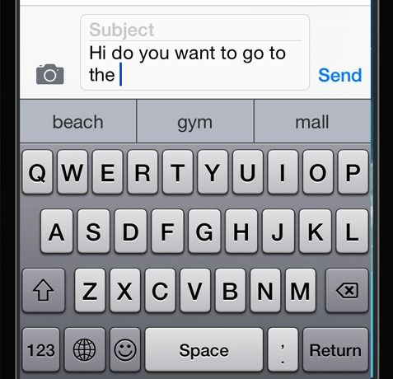
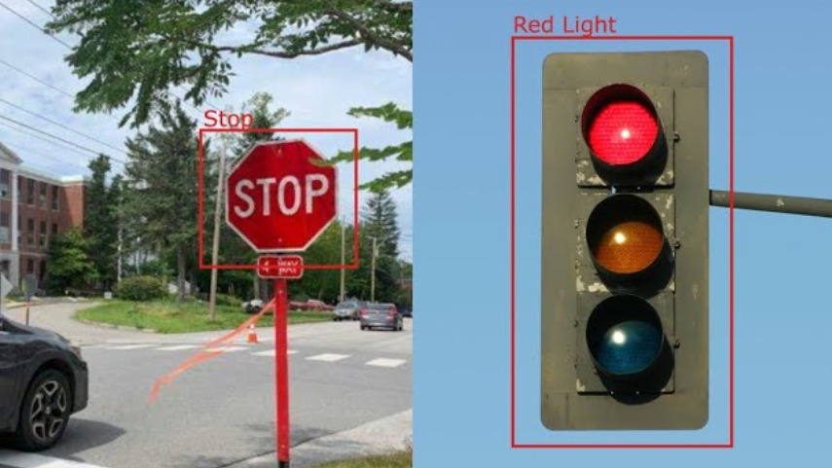
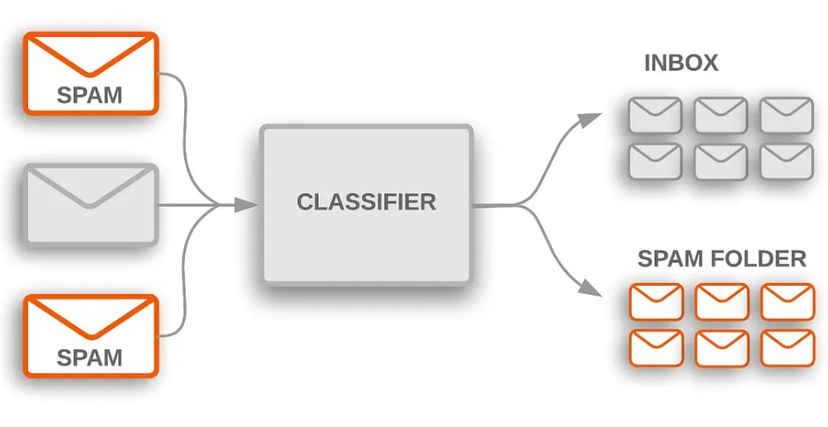
Machine Learning (ML)
Designing algorithms that ingest data and learn a model of the data
The learned model can be used to
Detect patterns/structures/themes/trends etc. in the data
Make predictions about future data and make decisions
Modern ML algorithms are heavily “data-driven”
No need to pre-define all the rules by humans (infeasible/impossible anyway)
The rules are not “static”; can adapt as the ML algo ingests more and more data
Next word prediction (key task in large-language models like ChatGPT)

Slide 9

Where Should We Use ML?
Handwritten digit recognition: Not too complex but still reasonably complex that an ML approach is desirable
When the learning problem is very complex, e.g.,
Enumerating all rules is infeasible or too time-consuming
Rules might evolve with time
In such cases, hard-coding the rules in a computer program may not work
Difficult to define and code all possible rules
Difficult to update the program if rules evolve
ML replaces the idea of humans writing code by humans supplying data
The ML algorithm automatically learns the model (the rules) from the supplied data
The model can evolve with more and more data

Slide 10

Artificial Intelligence (AI) vs Machine Learning
Often the terms AI and ML are used synonymously but don’t mean the same
AI is about endowing machines with intelligence
ML is a way to achieve AI by learning patterns/predictive models from data
AI is a much broader term and covers various sub-fields such as
Machine Learning
Natural Language Processing
Computer Vision
.. and many others
Can think of “deep learning” as a way of doing machine learning
And what about “deep learning”
Kind of a way to make machine learning more “automatic” (will discuss more later)

Slide 11
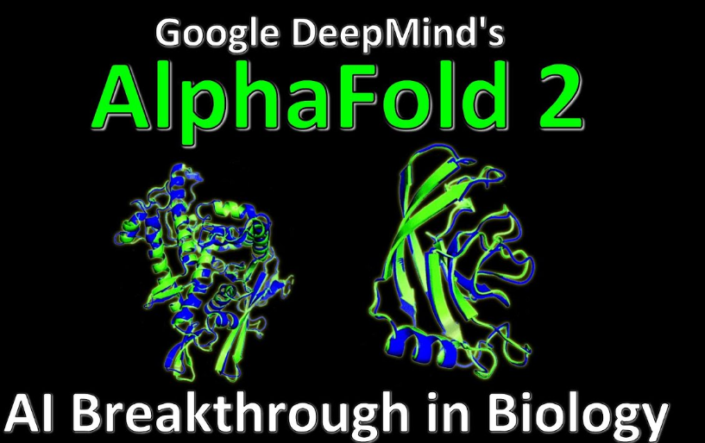
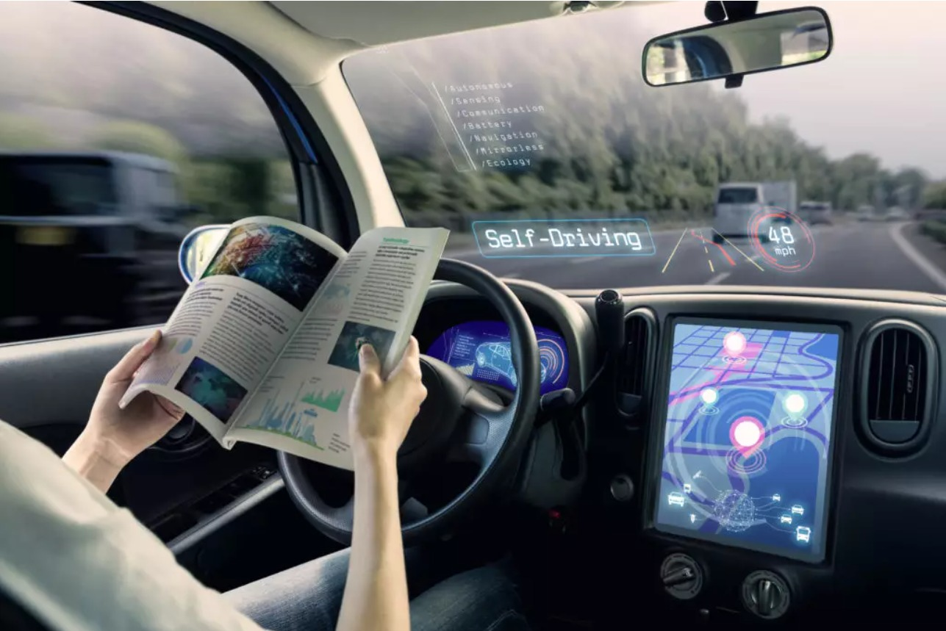
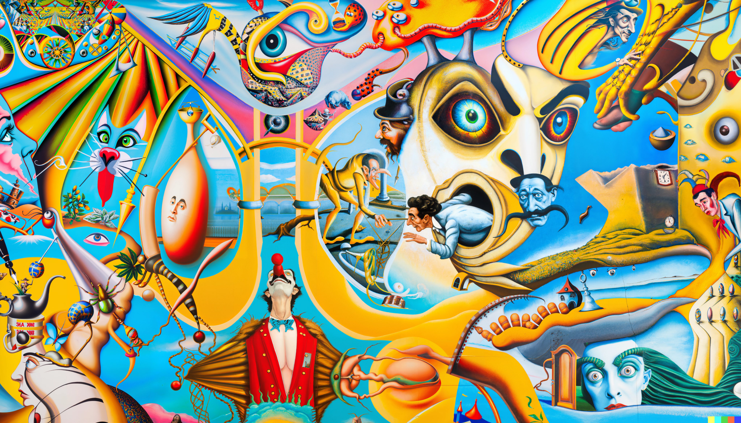
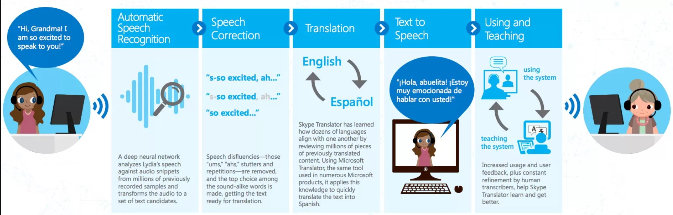

ML: Some Success Stories
Protein Structure Prediction
Autonomous Driving
AI Generated Digital Art (Dall E 2)
Real-time Speech Translation
Conversational Systems
Digital art pic credit: David Schnurr

Slide 12
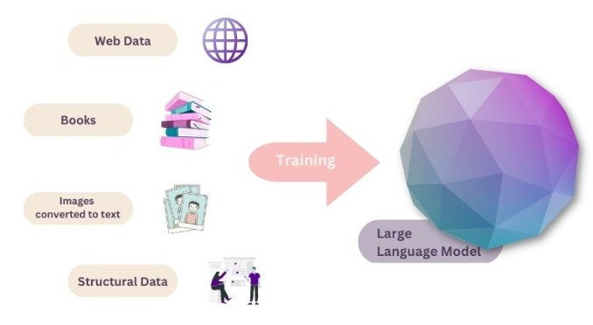

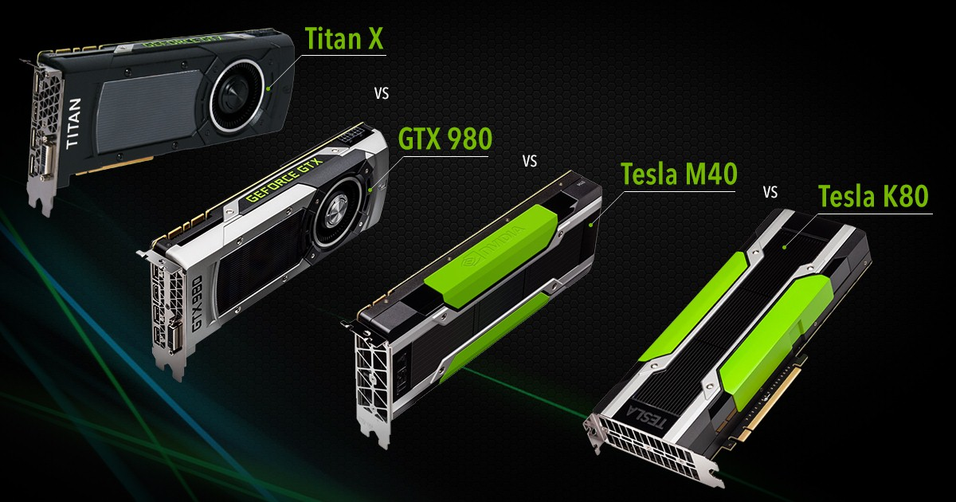
Key Enablers for Modern ML
Availability of large amounts of data to train ML models
Increased computing power (e.g., GPUs)

Slide 13


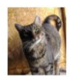

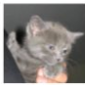
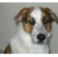
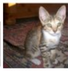


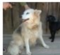
ML: A Simple Illustration
ML enables intelligent systems to be data-driven rather than rule-driven
How: By supplying training data and building statistical models of data
Pictorial illustration of an ML model for binary classification:
A Linear Classifier (the statistical model)

Slide 14
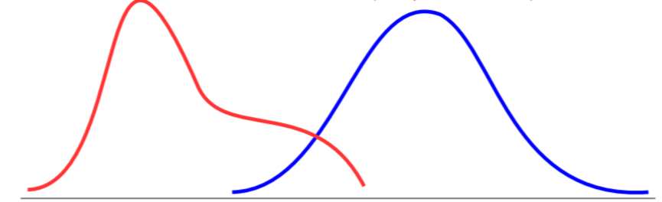

ML: A Simple Illustration
ML enables intelligent systems to be data-driven rather than rule-driven
How: By supplying training data and building statistical models of data
Pictorial illustration of an ML model for binary classification:
A Probabilistic Classifier (the statistical model)
P(“cat”|image)
P(“dog”|image)

Slide 15
ML: The Exam Anology
It’s the performance on the D-day which matters
In an exam, our success is measured based on how well we did on the questions in the test (not on the questions we practiced on)
Likewise, in ML, success of the learned model is measured based on how well it predicts/fits the future test data (not the training data)
In Machine Learning, generalization performance
on the test data matters
(we should not “overfit” on training data)

Slide 16
Coming Up Next..
Types of ML problems
Typical workflow of ML problems
Various perspectives of ML problems

Slide 17
A Loose Taxonomy of ML
“Labeled” means, during training, for each input, the corresponding output is available (i.e., the machine learner is explicitly told that a cat image is of a cat)
Learning using labeled data
Learning using unlabeled data
Some examples of
supervised learning problems
Classification
Regression
Ranking
Supervised
Learning
Unsupervised
Learning
Some examples of
unsupervised learning problems
Clustering
Dimensionality Reduction
Unsupervised Probability Density Estimation
Machine Learning
Many other specialized flavors of ML also exist,
some of which include
Semi-supervised Learning
Self-supervised Learning (very popular these days)
Active Learning
Transfer Learning
Multitask Learning
Zero-Shot/Few-Shot Learning
Continual learning
RL doesn’t use “labeled” or
“unlabeled” data in the traditional sense! In RL, an agent learns via
its interactions with an environment
Reinforcement Learning

Slide 18
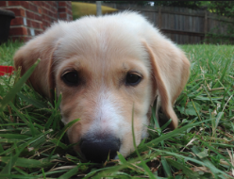
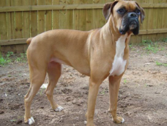
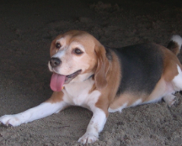
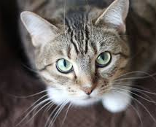


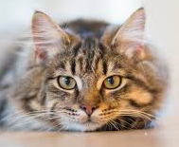
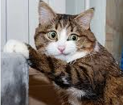
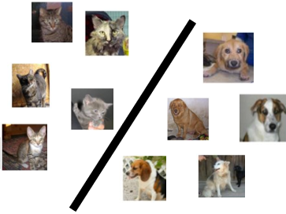
A Typical Supervised Learning Workflow
Note: This example is for the problem of binary classification, a supervised learning problem
Labeled
Training
Data
“dog”
“dog”
“dog”
“dog”
“dog”
Is feature extraction done “manually” as a pre-processing step before the ML algo starts working? Can’t we “automate” this part? Can’t we “learn” good features directly from raw inputs?
“cat”
“dog”
“cat”
“Feature”
Extraction
“cat”
ML Algorithm
(outputs a “model”)
“cat”
“cat”
“cat”
Feature extraction converts raw inputs to a numeric representation that the ML algo can understand and work with. More on feature extraction later.
Predicted Label
(cat/dog)
Test
Image
“Feature”
Extraction
Indeed. Deep Learning algos do precisely that!
(feature + model learning). More on Deep Learning later
Cat vs Dog
Prediction model
https://www.pinclipart.com/, http://www.pngtree.com

Slide 19
A Typical Unsupervised Learning Workflow
Note: This example is for the problem of data clustering, an unsupervised learning problem
Unlabeled
Data
Yes. In this example, given a new “test” cat/dog image, we can assign it to the cluster with closer centroid
“Feature”
Extraction
ML Algorithm
(outputs a clustering)
Does unsupervised learning also have a test phase? That is, can we also predict the cluster of a new test input?
https://www.pinclipart.com/, http://www.pngtree.com

Slide 20
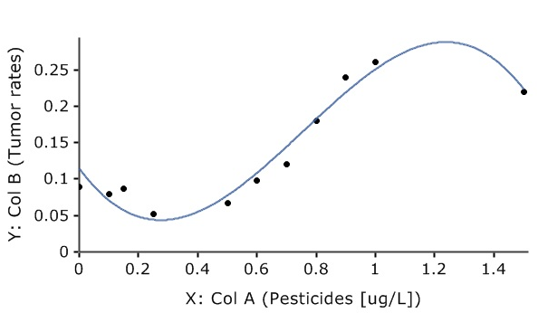
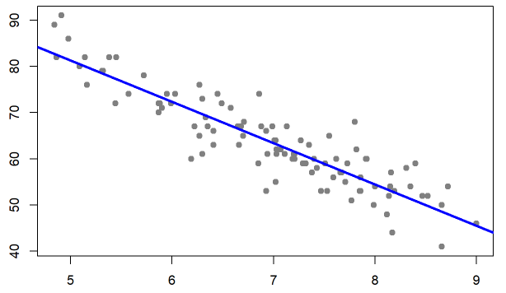
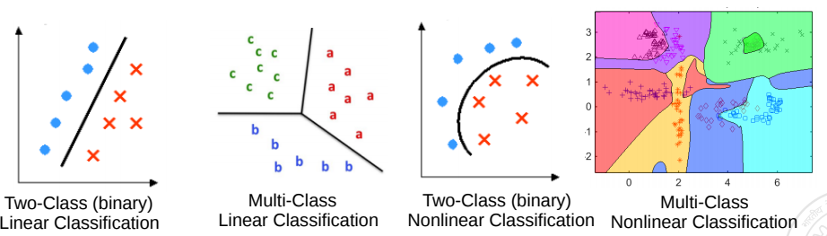
ML from Geometric Perspective
Recall that feature extraction converts inputs into a numeric representation
Basic fact: Inputs in ML problems can often be represented as points or vectors in some vector space
Doing ML on such data can thus be seen from a geometric view
Regression: A supervised learning problem. Goal is to model the relationship between input (x) and real-valued output (y). This is akin to a line or curve fitting problem
y: Grumpiness (scale of 0-100)
x: sleep hours
Classification: A supervised learning problem. Goal is to learn a to predict which of the two or more classes an input belongs to. Akin to learning linear/nonlinear separator for the inputs
Pic from: https://learningstatisticswithr.com/book/regression.html, https://maxstat.de/

Slide 21
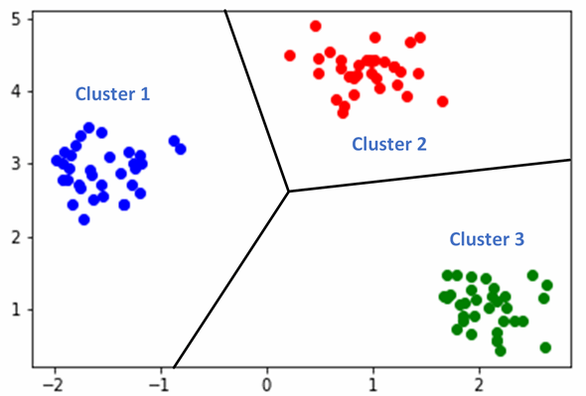
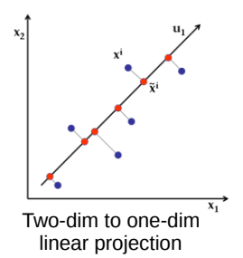
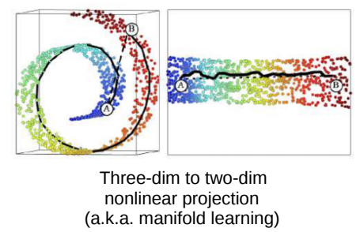
ML from Geometric Perspective
Clustering looks like classification to me. Is there any difference?
Clustering: An unsupervised learning problem. Goal is to group inputs in a few clusters based on their similarities with each other
Yes. In clustering, we don’t know the labels. Goal is to separate them without any labeled “supervision”
Dimensionality Reduction: An unsupervised learning problem. Goal is to compress the size of each input without losing much information present in the data

Slide 22
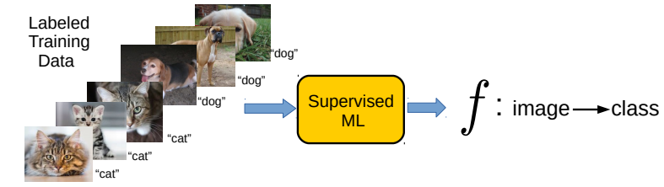
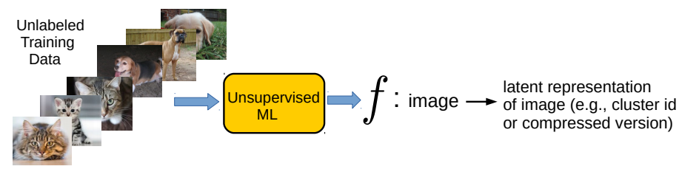
ML from Function Approximation Perspective
Supervised Learning (“predict output given input”) can be usually thought of as learning a function f that maps each input to the corresponding output
Unsupervised Learning (“model/compress inputs”) can also be usually thought of as learning a function f that maps each input to a compact representation
Reinforcement Learning can also be seen as doing function approximation
Harder since we don’t know the labels in this case

Slide 23
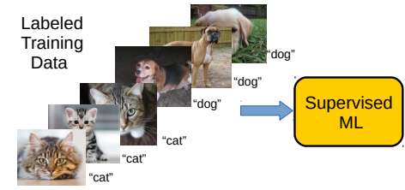
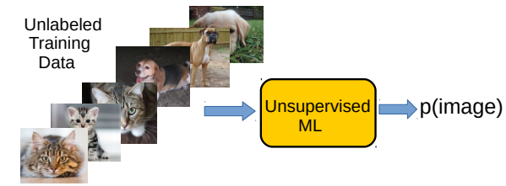
ML from Probability Estimation Perspective
Supervised Learning (“predict output given input”) can be thought of as estimating the conditional probability of each possible output given an input
Unsupervised Learning (“model/compress inputs”) can be thought of as estimating the probability density of the inputs
Reinforcement Learning can also be seen as estimating probability densities
p(label=“cat” | image)
Don’t worry if this doesn’t make much sense as of now ☺ But the basic idea is to learn the underlying data distribution using the unlabeled inputs; many ways to do this as we will see later
Harder since we don’t know the labels in this case

Slide 24
Next Class
Data and features
Some common machine learning paradigms
Simple supervised learners

